Slide 1
Statistical Learning
Measures of central tendency, dispersion, and correlation

Slide 2
Outline
Raw Data
Frequency Distribution - Histograms
Cumulative Frequency Distribution
Measures of Central Tendency
Mean, Median, Mode
Measures of Dispersion
Range, IQR, Standard Deviation,coefficient of variation
Normal distribution, Chebyshev Rule.
Five number summary, boxplots, QQ plots, Quantile plot, scatter plot.
Visualization: scatter plot matrix.
Correlation analysis

Slide 3
Data versus Information
When analysts are bewildered by plethora of data, which do not make any sense on the surface of it, they are looking for methods to classify data that would convey meaning. The idea here is to help them draw the right conclusion. Data needs to be arranged into information.

Slide 4
Raw Data
Raw Data represent numbers and facts in the original format in which the data have been collected. We need to convert the raw data into information for decision making.

Slide 5
Frequency Distribution
In simple terms, frequency distribution is a summarized table in which raw data are arranged into classes and frequencies.
Frequency distribution focuses on classifying raw data into information. It is a widely used data reduction technique in descriptive statistics.

Slide 6
HISTOGRAM
Histogram (also known as frequency histogram) is a snap shot of the frequency distribution.
Histogram is a graphical representation of the frequency distribution in which the X-axis represents the classes and the Y-axis represents the frequencies in bars
Histogram depicts the pattern of the distribution emerging from the characteristic
being measured.

Slide 7
Histogram- Example
The inspection records of a hose assembly operation revealed a high level of rejection. An analysis of the records showed that the "leaks" were a major contributing factor to the problem. It was decided to investigate the hose clamping operation. The hose clamping force (torque) was measured on twenty five assemblies. (Figures in foot-pounds). The data are given below: Draw the frequency histogram and comment.
8 | 13 | 15 | 10 | 16
11 | 14 | 11 | 14 | 20
15 | 16 | 12 | 15 | 13
12 | 13 | 16 | 17 | 17
14 | 14 | 14 | 18 | 15

Slide 8
Histogram Example Solution
15
12
10
7
Fre quency
5
2
3
1
0
8-11
11-14
14-17
Classes
17-20
20-23

Slide 9
Cumulative Frequency Distribution
A type of frequency distribution that shows how many observations are above or below the lower boundaries of the classes. You can formulate the following from the previous example of hose clamping force(torque)
Class | Frequency | Relative Frequency | Cumulative Frequency | Cumulative Relative Frequency
8-11 11-14 14-17 17-20 20-23 | 2 7 12 3 1 | 0.08 0.28 0.48 0.12 0.04 | 2 9 21 24 25 | 0.08 0.36 0.84 0.96 1.00
Total | 25 | 1.00

Slide 10
Cumulative Distribution Function
Cumulative Distribution (Ogive Curve) for the Example
30
Cumulative ²⁰
Frequency ₁₀
0
24
25
21
9
2
11
14 17 20
Torque(less than value)
23

Slide 11
What is Central Tendency?
Whenever you measure things of the same kind, a fairly large number of such measurements will tend to cluster around the middle value. Such a value is called a measure of "Central Tendency". The other terms that are used synonymously are "Measures of Location", or "Statistical Averages".

Slide 12
Arithmetic Mean
Arithmetic Mean (called mean) is defined as the sum of all observations in a data set divided by the total number of observations. For example, consider a data set containing the following observations:
In symbolic form mean is given by
X = ^{∑ X}
n
X ^{= Arithmetic Mean}
∑ X
n
= Indicates sum all X values in the data set
= Total number of observations(Sample Size)

Slide 13
Arithmetic Mean -Example
The inner diameter of a particular grade of tire based on
5 sample measurements are as follows: (figures in
millimeters)
565, 570, 572, 568, 585
∑X
Applying the formula
X =
n
We get mean = (565+570+572+568+585)/5 =572
Caution: Arithmetic Mean is affected by extreme values or fluctuations in sampling. It is not the best average to use when the data set contains extreme values (Very high or very low values).

Slide 14
Median
Median is the middle most observation when you arrange data in ascending order of magnitude. Median is such that 50% of the observations are above the median and 50% of the observations are below the median.
Median is a very useful measure for ranked data in the context of consumer preferences and rating. It is not affected by extreme values (greater resistance to outliers)
Median = ^{n +1}
th value of ranked data
2
n = Number of observations in the sample

Slide 15
Median - Example
Marks obtained by 7 students in Computer Science Exam are given below: Compute the median.
45 40 60 80 90 65 55
Arranging the data after ranking gives
90 80 65 60 55 45 40
Median = (n+1)/2 th value in this set = (7+1)/2 th
observation= 4th observation=60
Hence Median = 60 for this problem.

Slide 16
Mode
Mode is that value which occurs most often. It has the maximum frequency of occurrence. Mode also has resistance to outliers.
Mode is a very useful measure when you want to keep in the inventory, the most popular shirt in terms of collar size during festive season.

Slide 17
Mode -Example
The life in number of hours of 10 flashlight batteries are as follows: Find the mode.
340 | 350 | 340 | 340 | 320 | 340 | 330 | 330
340 | 350
340 occurs five times. Hence, mode=340.

Slide 18
Comparison of
Mean, Median, Mode
Mean | Median | Mode
Defined as the arithmetic average of all observations in the data set. Requires measurement on all observations. Uniquely and comprehensively defined. | Defined as the middle value in the data set arranged in ascending or descending order. Does not require measurement on all observations Cannot be uniquely determined under all conditions. | Defined as the most frequently occurring value in the distribution; it has the largest frequency. Does not require measurement on all observations Not uniquely defined for multi-modal situations.

Slide 19
Comparison of
Mean, Median, Mode Cont.
Mean | Median | Mode
Affected by extreme values. Can be treated algebraically. That is, Means of several groups can be combined. | Not affected by extreme values. Cannot be treated algebraically. That is, Medians of several groups cannot be combined. | Not affected by extreme values. Cannot be treated algebraically. That is, Modes of several groups cannot be combined.

Slide 20
Measures of Dispersion
In simple terms, measures of dispersion indicate how large the spread of the distribution is around the central tendency. It answers unambiguously the question " What is the magnitude of departure from the average value for different groups having identical averages?".

Slide 21
Range
Range is the simplest of all measures of dispersion. It is calculated as the difference between maximum and minimum value in the data set.
Range =
^{X}Maximum ^{− X}Minimum

Slide 22

Range-Example
Example for Computing Range
The following data represent the percentage return on investment for
10 mutual funds per annum. Calculate Range.
12, 14, 11, 18, 10.5, 11.3, 12, 14, 11, 9
Range = = 18-9=9
Caution: If one of the components of range namely the maximum value or minimum value becomes an extreme value, then range should not be used.

Slide 23
Inter-Quartile Range(IQR)
IQR= Range computed on middle 50% of the observations after eliminating the highest and lowest 25% of observations in a data set that is arranged in ascending order. IQR is less affected by outliers.
IQR =Q₃-Q₁

Slide 24
Interquartile Range-Example
The following data represent the annual percentage returns of 9 mutual funds.
Data Set: 12, 14, 11, 18, 10.5, 12, 14, 11, 9
Arranging in ascending order, the data set becomes
9, 10.5, 11, 11, 12, 12, 14, 14, 18
IQR=Q₃-Q₁=14-10.75=3.25

Slide 25
Standard Deviation
To define standard deviation, you need to define another term called variance. In simple terms, standard deviation is the square root of variance.

Slide 26
Example for Standard Deviation
The following data represent the percentage return on investment for 10 mutual funds per annum. Calculate the sample standard deviation.
12, 14, 11, 18, 10.5, 11.3, 12, 14, 11, 9

Slide 27
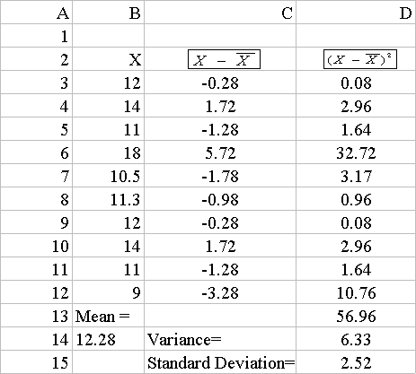
Solution for the Example

Slide 28
Standard Deviation Formula

Slide 29
Coefficient of Variation
(Relative Dispersion)
CoefficientvVariation (CV) is defined as the ratio of Standard Deviation to Mean.
In symbolic form
CV = ^{S}
σ
for the sample data and =
for the population
X
μ

Slide 30
Coefficient of Variation Example
Consider two SalesPersons working in the same territory
The sales performance of these two in the context of selling PCs are given below. Comment on the results.
Sales Person 1
Mean Sales (One year average)
50 units
Sales Person 2
Mean Sales (One year average)
75 units
Standard Deviation
5 units
Standard deviation 25 units

Slide 31
Interpretation for the Example
The CV is 5/50 =0.10 or 10% for the Sales Person1
and 25/75=0.33 or 33% for sales Person2.
The moral of the story is "don't get carried away by by averages. Consider variation (“risk”).

Slide 32
The Empirical Rule
The empirical rule approximates the variation of data in a bell-shaped distribution
Approximately 68% of the data in a bell shaped distribution
is within 1 standard deviation of the mean or
μ ± 1σ
68%
μ
μ ± 1σ

Slide 33
The Empirical Rule
Approximately 95% of the data in a bell-shaped distribution lies within two standard deviations of the mean, or µ ± 2σ
Approximately 99.7% of the data in a bell-shaped distribution lies within three standard deviations of the mean, or µ ± 3σ
95%
99.7%
μ ± 2σ
μ ± 3σ

Slide 34
Chebyshev Rule
Regardless of how the data are distributed, at least (1 - 1/k²) x 100% of the values will fall within k standard deviations of the mean (for k > 1)
For Example, when k=2, at least 75% of the values of any data set will be within _{μ ± 2σ}

Slide 35
The Five Number Summary
The five numbers that help describe the center, spread and shape of data are:
^{X}smallest
First Quartile (Q₁)
Median (Q₂)
Third Quartile (Q₃)
^{X}largest

Slide 36
Distribution Shape
Left-Skewed
Symmetric
Right-Skewed
Q₁ Q₂ Q₃
Q₁ Q₂ Q₃
Q₁ Q₂ Q₃

Slide 37
Relationships among the five-number
summary and distribution shape
Left-Skewed | Symmetric | Right-Skewed
Median – X_{smallest} > X_{largest} – Median | Median – X_{smallest} ≈ X_{largest} – Median | Median – X_{smallest} < X_{largest} – Median
^{Q}1 ^{– X}smallest > ^{X}largest ^{– Q}3 | ^{Q}1 ^{– X}smallest ≈ ^{X}largest ^{– Q}3 | ^{Q}1 ^{– X}smallest < ^{X}largest ^{– Q}3
Median – Q₁ > Q₃ – Median | Median – Q₁ ≈ Q₃ – Median | Median – Q₁ < Q₃ – Median

Slide 38
Five Number Summary and The Boxplot
The Boxplot: A Graphical display of the data based on the five-number summary:
Example:
25% of data | 25% of data | 25% of data | 25% of data
^{X}smallest
Q₁ Median Q₃
^{X}largest
40

Slide 39
Five Number Summary:
Shape of Boxplots
If data are symmetric around the median then the box
and central line are centered between the endpoints
^{X}smallest
Median
Q₁ Q₃
^{X}largest
A Boxplot can be shown in either a vertical or
horizontal orientation

Slide 40
Distribution Shape and
The Boxplot
Left-Skewed
Symmetric
Right-Skewed
Q₁ Q₂ Q₃
Q₁ Q₂ Q₃
Q₁ Q₂ Q₃

Slide 41
Boxplot Example
₅
The data are right skewed in the following plot
₀0 2₂ 3₃ 5₅
₂2₇7

Slide 42
Box plot example showing an outlier
The boxplot below of the same data shows the
outlier value of 27 plotted separately
A value is considered an outlier if it is more than 1.5 times the interquartile range below Q₁ or above Q₃
0
5
10
15
20
25
30

Slide 43
Graphic Displays of Basic Statistical Descriptions
Boxplot: graphic display of five-number summary
Histogram: x-axis are values, y-axis repres. frequencies
Quantile plot: each value x_{i} is paired with f_{i} indicating that approximately 100 f_{i} % of data are ≤ x_{i}
Quantile-quantile (q-q) plot: graphs the quantiles of one univariant distribution against the corresponding quantiles of another
Scatter plot: each pair of values is a pair of coordinates and plotted as points in the plane
Notes:
JH: Maybe we can remove Loess curve

Slide 44
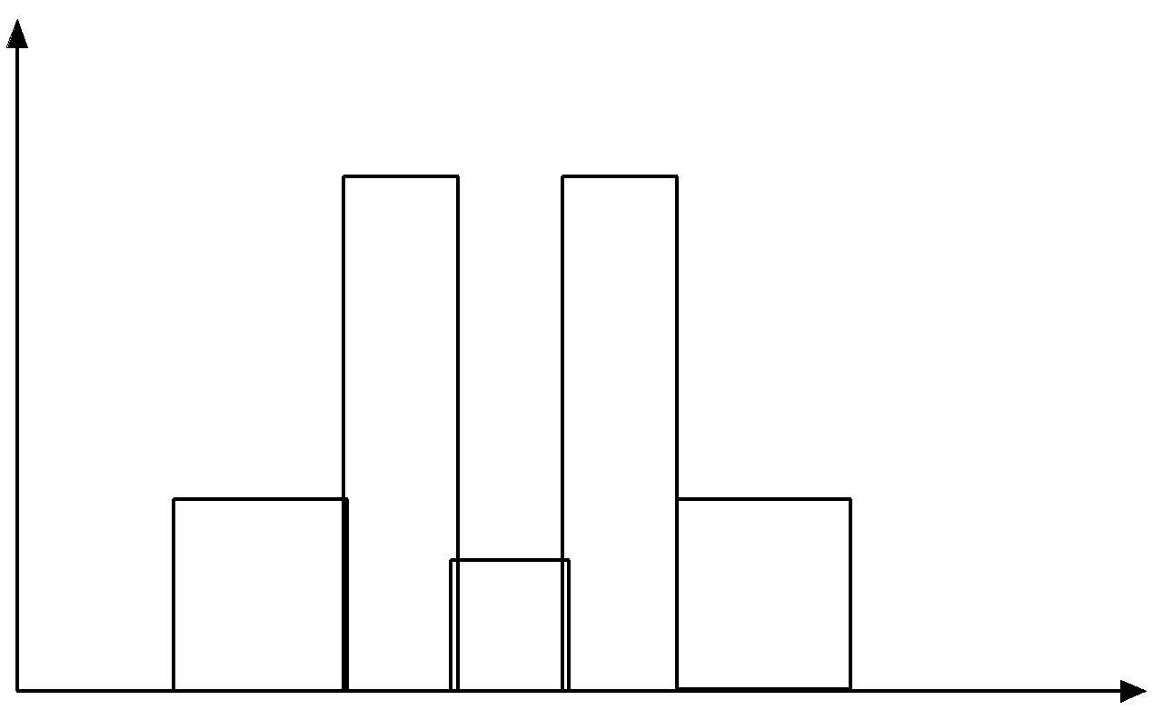
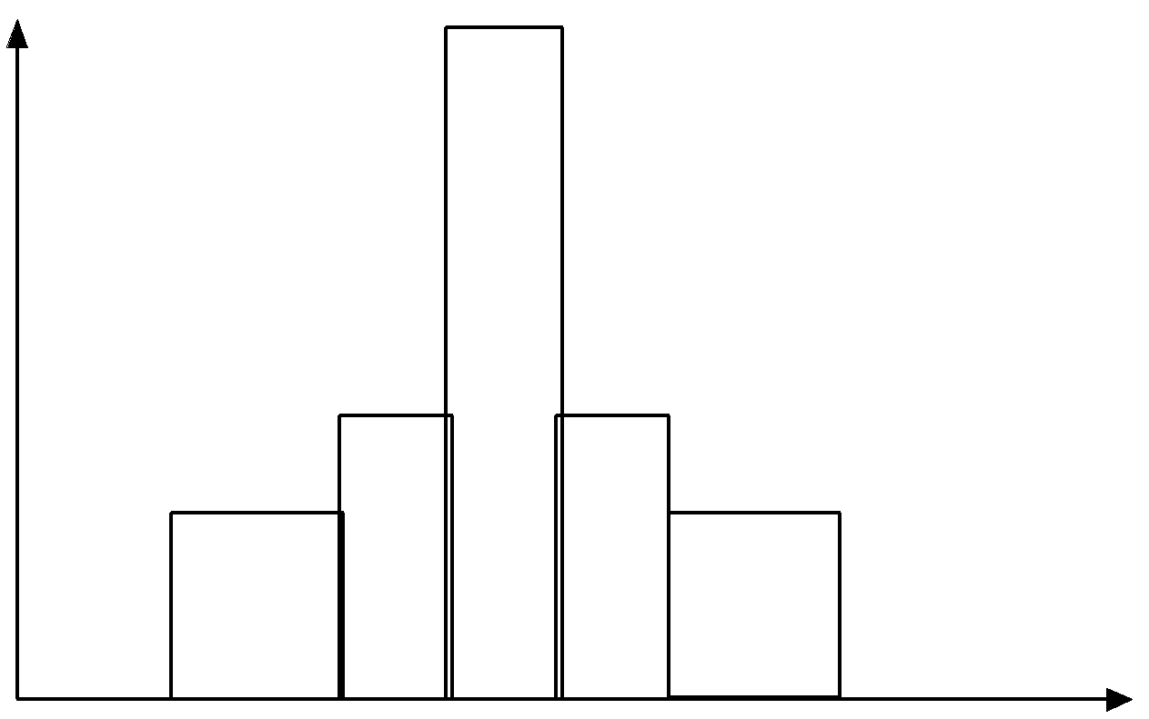
Histograms Often Tell More than Boxplots
The two histograms shown in the left may have the same boxplot representation
The same values for: min, Q1, median, Q3, max
But they have rather different data distributions

Slide 45
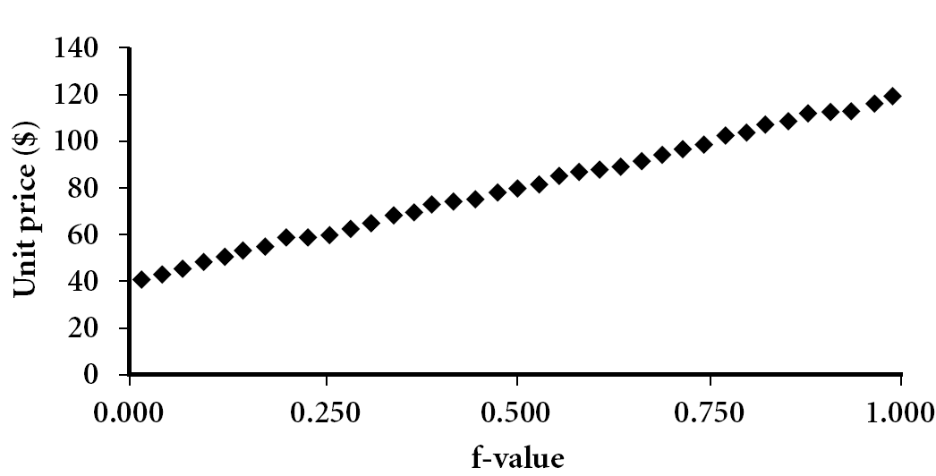
Quantile Plot
Displays all of the data (allowing the user to assess both the overall behavior and unusual occurrences)
Plots quantile information
For a data x_{i} data sorted in increasing order, f_{i} indicates that approximately 100 f_{i}% of the data are below or equal to the value x_{i}

Slide 46
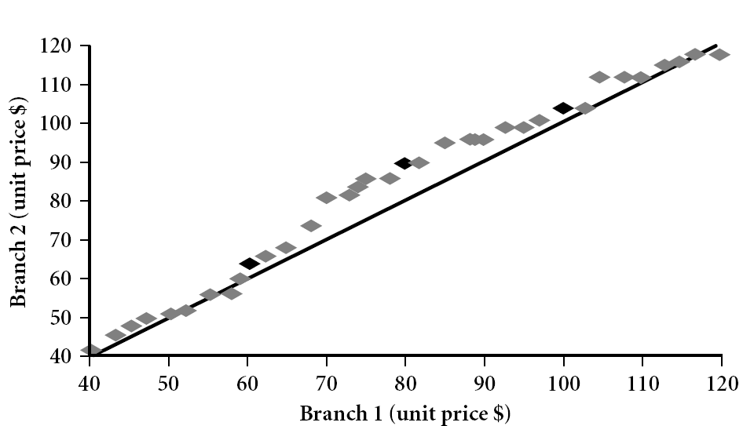
Quantile-Quantile (Q-Q) Plot
Graphs the quantiles of one univariate distribution against the corresponding quantiles of another
View: Is there is a shift in going from one distribution to another?
Example shows unit price of items sold at Branch 1 vs. Branch 2 for each quantile. Unit prices of items sold at Branch 1 tend to be lower than those at Branch 2.
Notes:
Note: We need to label the dark plotted points as Q1, Median, Q3 – that would help in understanding this graph.
Tell audience: There is a shift in distribution of branch 1 WRT branch 2 in that the unit prices of items sold at branch 1 tend to be lower than those at branch 2.

Slide 47
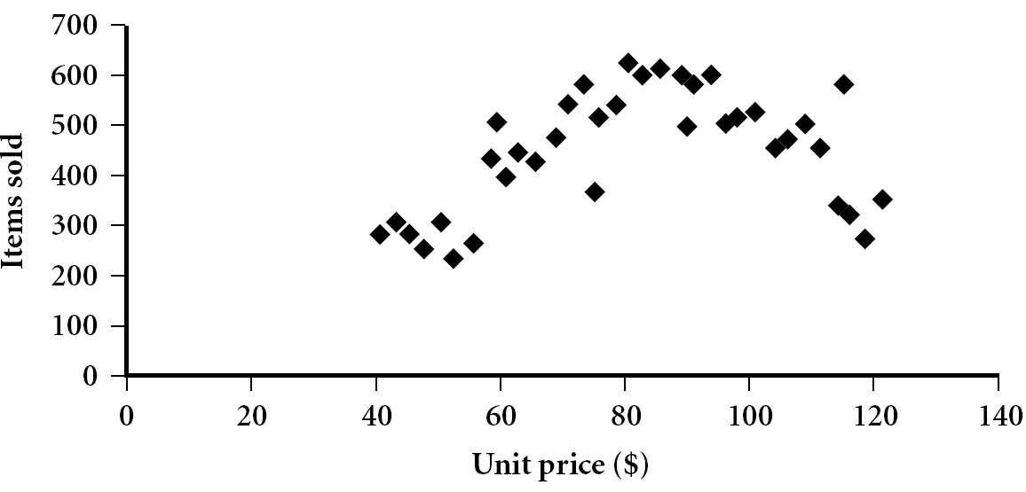
Scatter plot
Provides a first look at bivariate data to see clusters of points, outliers, etc
Each pair of values is treated as a pair of coordinates and plotted as points in the plane
Notes:
Need a better and more MEANINGFUL scatter plot! -JH

Slide 48
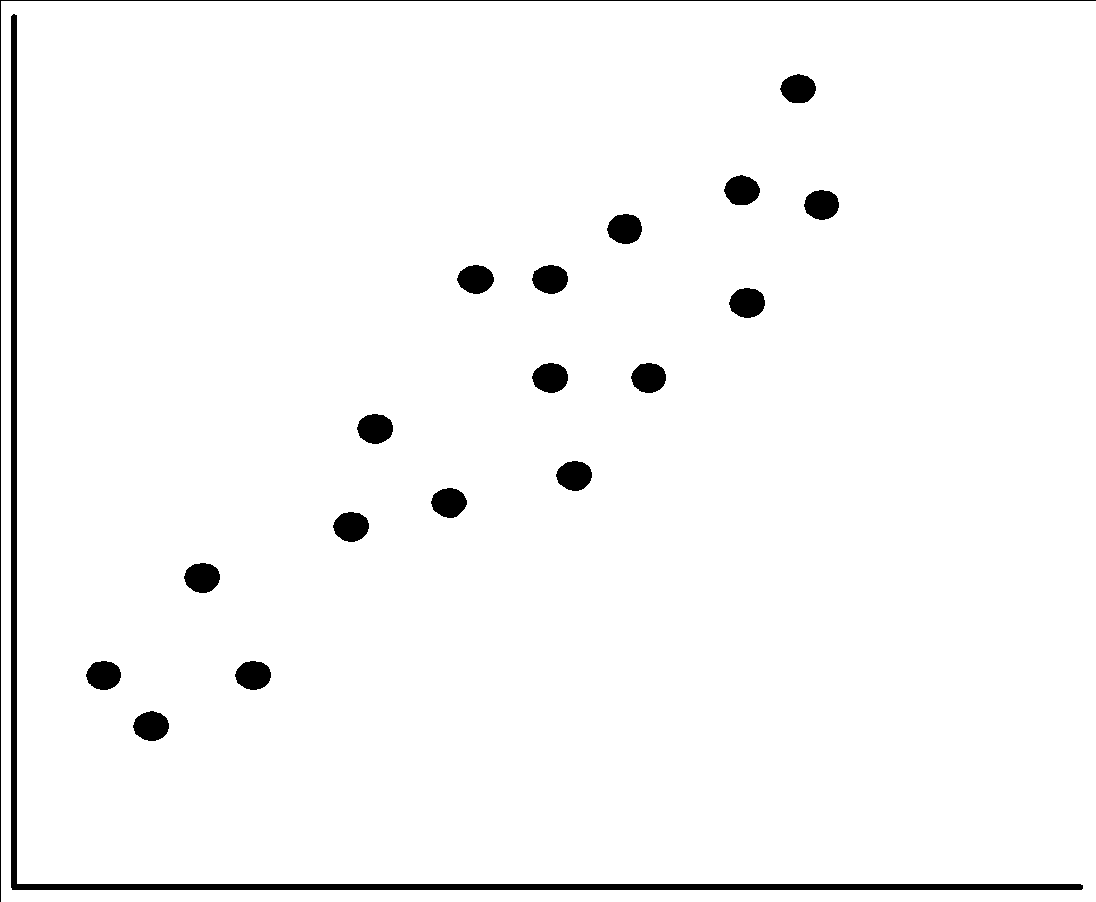
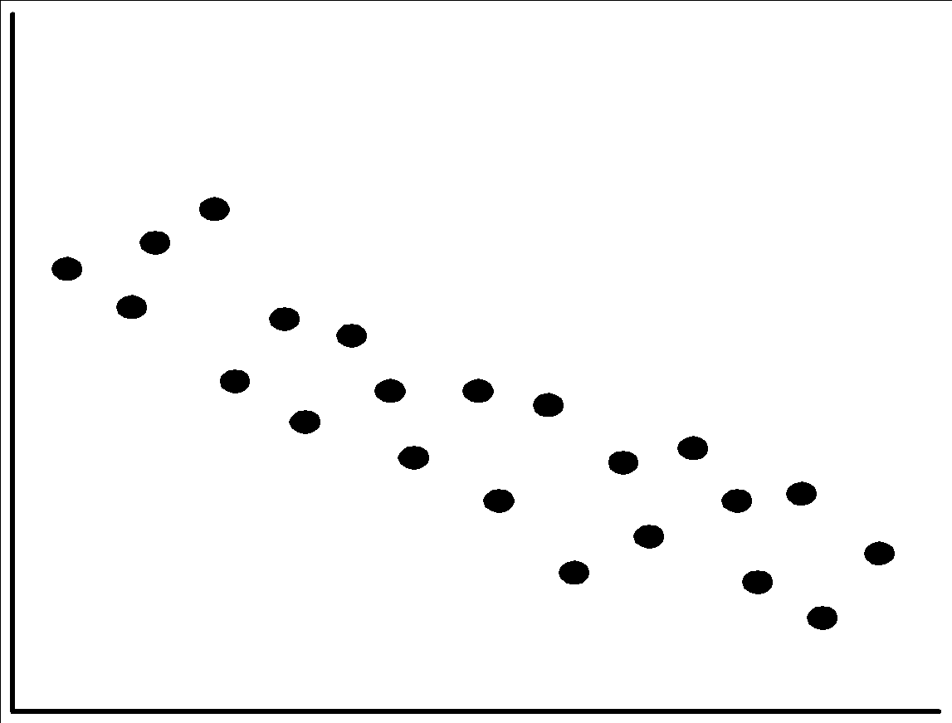
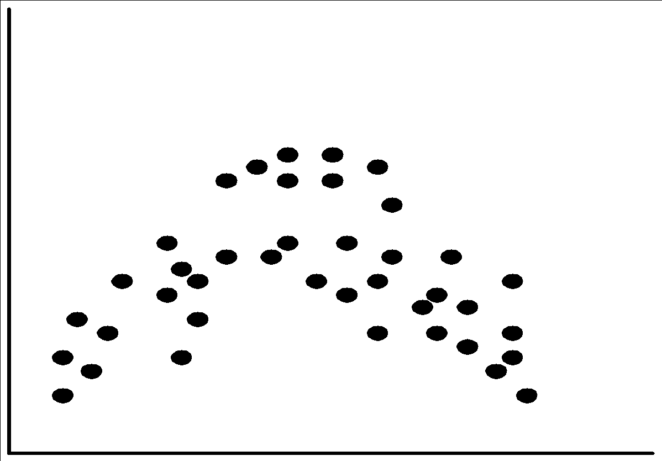
Positively and Negatively Correlated Data
The left half fragment is positively correlated
The right half is negative correlated

Slide 49
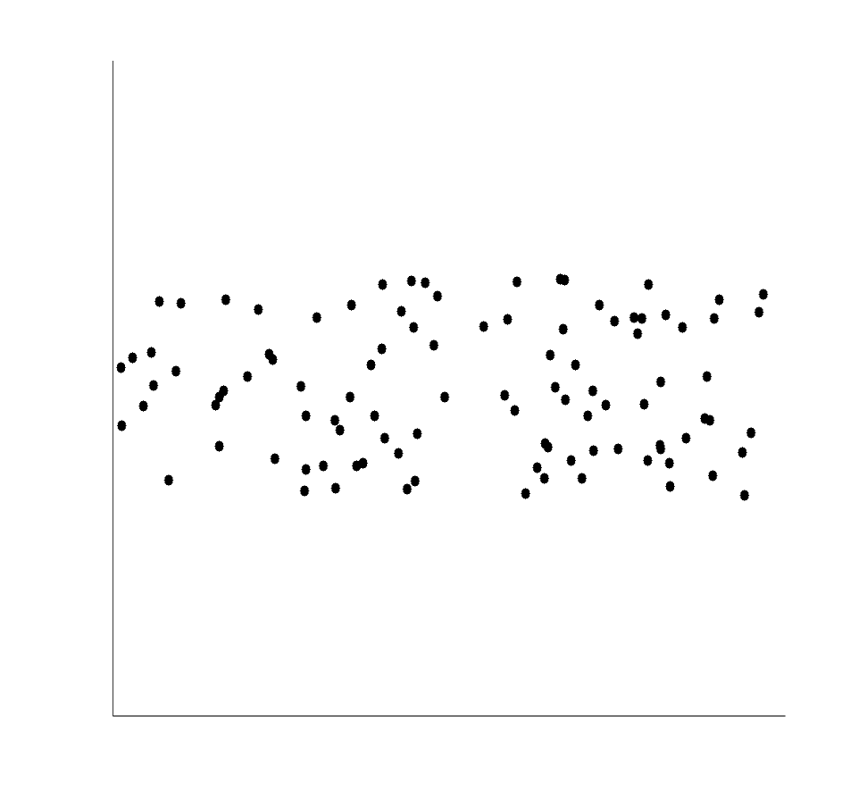
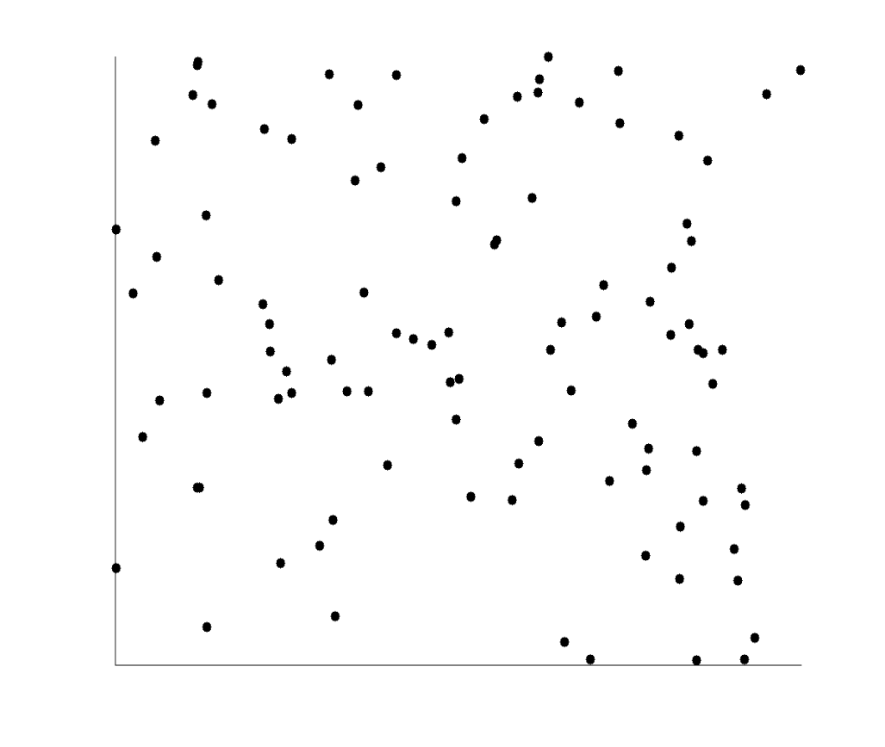
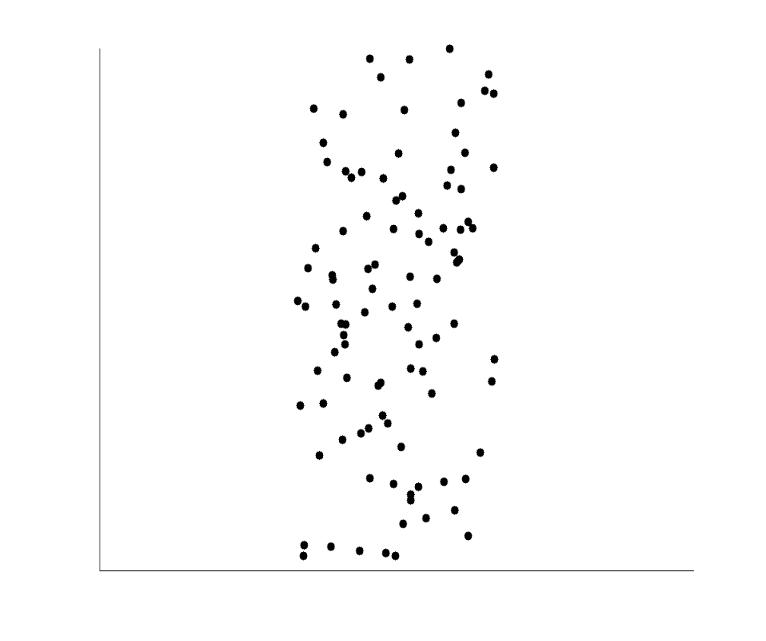
Uncorrelated Data

Slide 50
Data Visualization
Why data visualization?
Gain insight into an information space by mapping data onto graphical primitives
Provide qualitative overview of large data sets
Search for patterns, trends, structure, irregularities, relationships among data
Help find interesting regions and suitable parameters for further quantitative analysis
Provide a visual proof of computer representations derived
Categorization of visualization methods:
Pixel-oriented visualization techniques
Geometric projection visualization techniques
Icon-based visualization techniques
Hierarchical visualization techniques
Visualizing complex data and relations
Notes:
CC (conference call) 08.11.02: Need to check Wiki to update references.

Slide 51
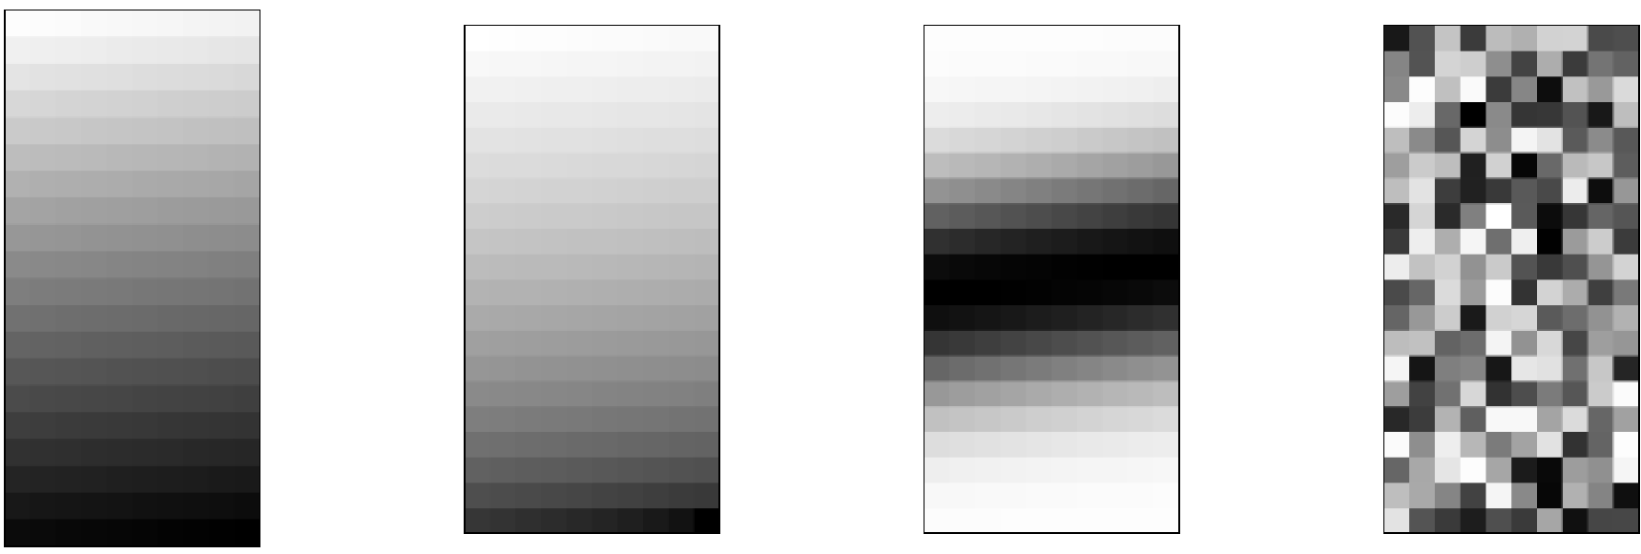
Pixel-Oriented Visualization Techniques
For a data set of m dimensions, create m windows on the screen, one for each dimension
The m dimension values of a record are mapped to m pixels at the corresponding positions in the windows
The colors of the pixels reflect the corresponding values
Income
(b) Credit Limit
(c) transaction volume
(d) age
51
Notes:
51
CC (conference call) 08.11.02: Need to check Wiki to update references.

Slide 52
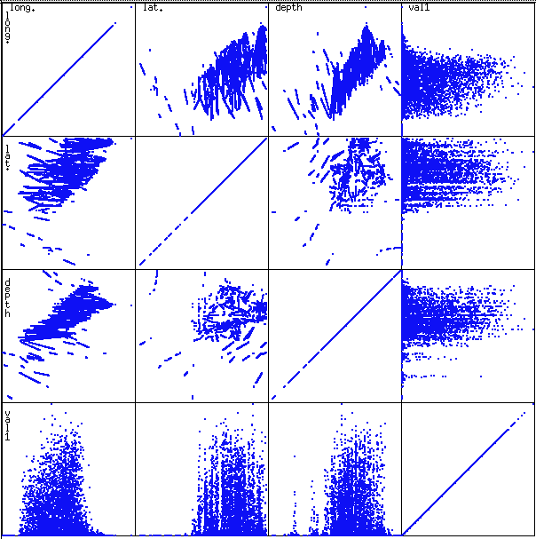
Scatterplot Matrices
Used by ermission of M. Ward, Worcester Polytechnic Institute
Matrix of scatterplots (x-y-diagrams) of the k-dim. data [total of (k2/2-k) scatterplots]

Slide 53
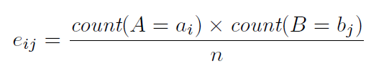
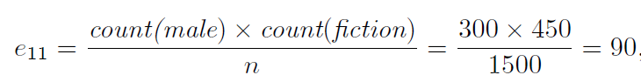
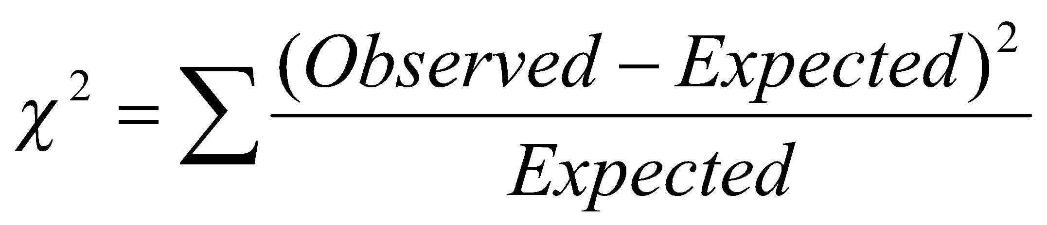

Correlation Analysis (Nominal Data): Chi-Square Test
 | Play chess | Not play chess | Sum (row)
Like science fiction | 250(90) | 200(360) | 450
Not like science fiction | 50(210) | 1000(840) | 1050
Sum(col.) | 300 | 1200 | 1500
Χ² (chi-square) calculation (numbers in parenthesis are expected counts calculated based on the data distribution in the two categories)
Shows that like_science_fiction and play_chess are correlated in the group.
For this 2 × 2 table, the degrees of freedom are (2 − 1)(2 − 1) = 1. For 1 degree of freedom, the 2 value needed to reject the hypothesis at the 0.001 significance level is 10.828

Slide 54
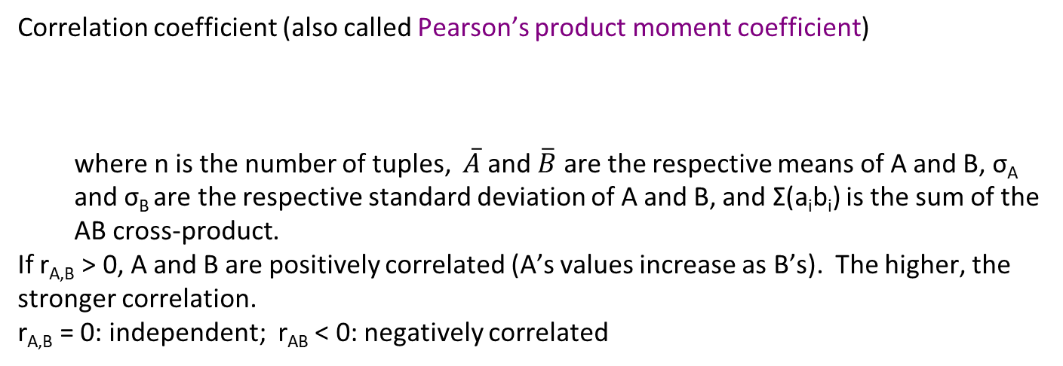
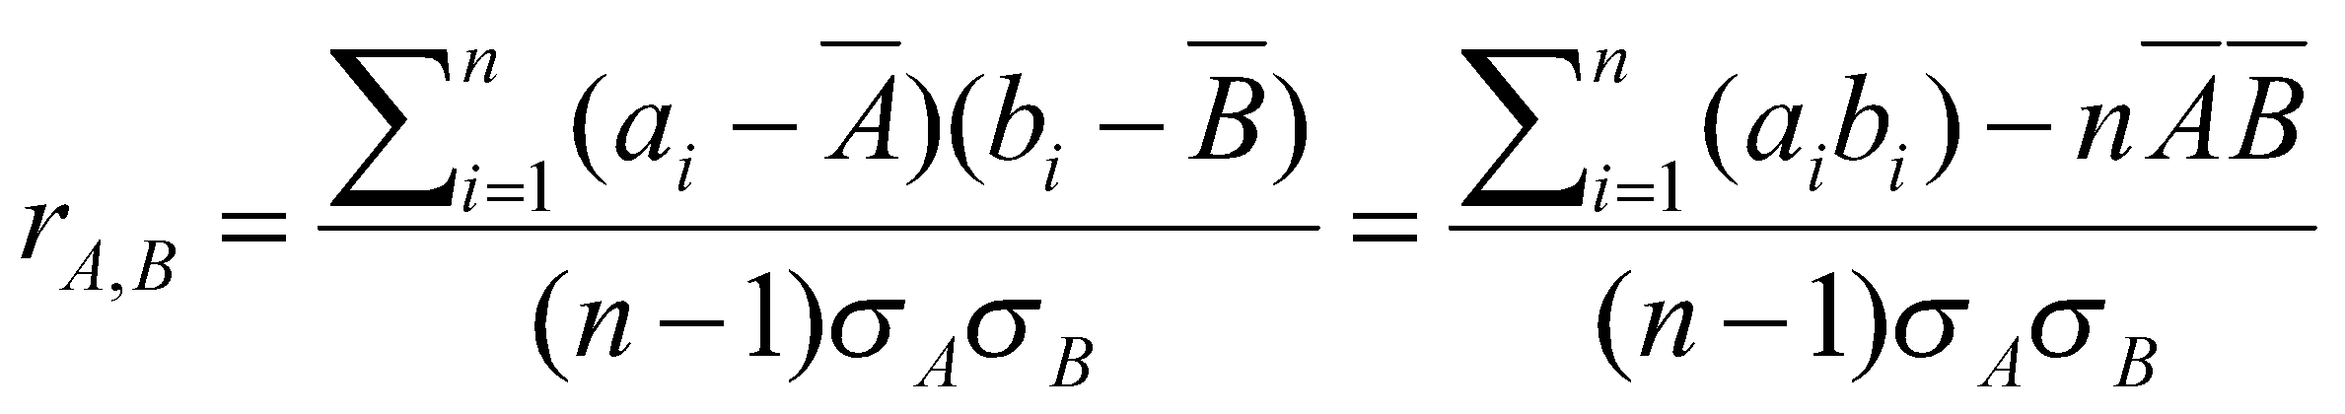
Correlation Analysis (Numeric Data)

Slide 55
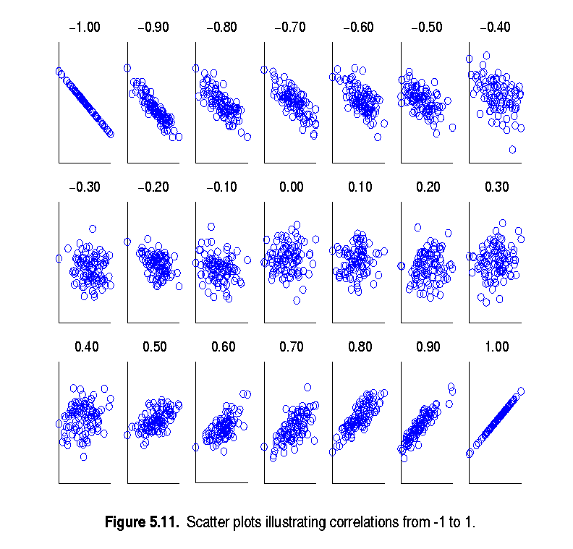
Visually Evaluating Correlation
Scatter plots showing the similarity from –1 to 1.

Slide 56
Summary
Histograms
Measures of central tendency: mean, mode, median
Measures of dispersion: range, IQR, variance, std deviation, coefficient of variation.
Normal distribution, Chebyshev Rule.
Five number summary, boxplots, QQ plots, Quantile plot, scatter plot.
Visualization: scatter plot matrix, parallel coordinates.
Correlation analysis.
Notes:
08/10/23: This slide was out of date. Draft of new version above.
Cut out the following:
Data description, data exploration, and measure data similarity set the basis for quality data preprocessing
A lot of methods have been developed but data preprocessing still an active area of research

